Slide 1


Mathio Bros.: Where Math is Fun!
Welcome to Mathio Bros, an innovative educational game designed to make learning math fun and interactive.
By Lior Panikashvili and Maayan Etzioni supervisor: Moshe Sulamy

Slide 2

The Importance of Mathematical Understanding
Critical Thinking
Real-World Applications
Academic Foundation
Notes:
Critical Thinking: Mathematics fosters logical reasoning and problem-solving abilities essential for success in various fields.
Real-World Applications: Math skills are crucial for navigating everyday situations and understanding complex concepts in science and technology.
Academic Foundation: Early mathematical experiences lay the groundwork for future academic success across multiple disciplines.

Slide 3
Benefits of Gamified Math Learning
Active Engagement
Immediate Feedback
Gamification transforms passive learning into an interactive experience
In-game feedback mechanisms allowing quick adjustments
Safe Environment
Games provide a risk-free space for experimentation and learning from mistakes
Notes:
Active Engagement: Gamification transforms passive learning into an interactive experience, leading to deeper understanding and improved retention of mathematical concepts.
Safe Environment: Games provide a risk-free space for experimentation and learning from mistakes, reducing math anxiety and building confidence.
Immediate Feedback: In-game feedback mechanisms offer timely responses to learner actions, allowing for quick adjustments and reinforcing correct understanding.

Slide 4
Multiplayer Fun
Team Up!
Work Together
Challenge your friends to a multiplayer game where you can compete and learn together.
Solve puzzles and overcome obstacles as a team, helping each other along the way.

Slide 5

Collaborative Learning in Mathematics
Diverse Perspectives
Enhanced Communication
leading to richer learning experiences.
Collaboration helps students articulate their mathematical reasoning.
Peer Support
Working together allows for a positive learning environment.
Notes:
Diverse Perspectives: Students share different approaches to problem-solving, leading to richer learning experiences.
Enhanced Communication: Collaborative activities encourage students to articulate their mathematical thinking and reasoning.
Peer Support: Working together allows students to learn from and support each other, fostering a positive learning environment.

Slide 6
Supervise: Track Your Progress
Parent/Teacher Dashboard
See the Results
A special dashboard lets parents or teachers track their child's progress.
Review completed levels, correct answers, and areas where they might need extra practice.

Slide 7

Effective Supervision in Math Education
1
Guidance and Scaffolding
Skilled educators provide crucial support.
2
Personalized Instruction
Supervision allows teachers to tailor instruction accordingly.
3
Supportive Environment
Consistent supervision fosters a positive learning atmosphere.
Notes:
Guidance and Scaffolding: Skilled educators provide crucial support, helping students navigate challenging concepts and develop effective problem-solving strategies.
Personalized Instruction: Supervision allows teachers to observe learning processes, identify individual needs, and tailor instruction accordingly.
Supportive Environment: Consistent supervision fosters a positive learning atmosphere where students feel comfortable taking risks and learning from mistakes.

Slide 8
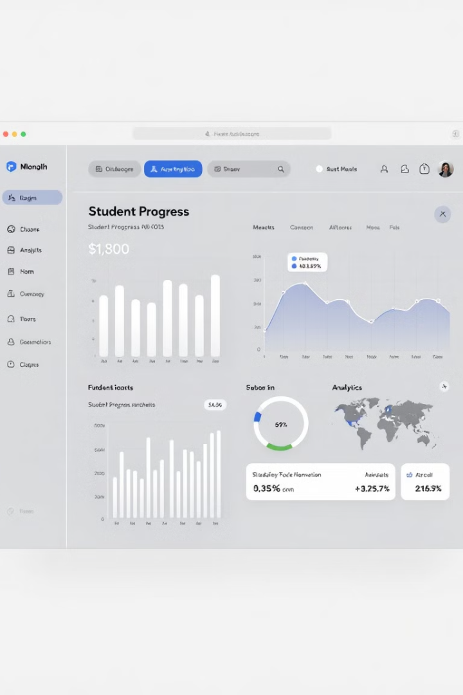




Tools for Supervision and Data Analysis
Next.js
Build scalable web applications for comprehensive analytics.
React.js
Create modular and efficient user interfaces for data visualization.
Material-UI
Deliver a polished and user-friendly interface for supervisors.
Recharts
Generate clear and visually appealing data visualizations for progress tracking.

Slide 9

Level Builder: Unleash Your Creativity
Design
Challenge
Learn
Create your own custom levels and share them with your friends.
Test your skills and challenge others with your creative designs.
Experiment with different challenges and learn as you build and play.

Slide 10



Interactive Tutorials: Learn by Doing!
Step by Step
Practice
Learn new concepts with interactive tutorials that guide you through each step.
Practice what you learned with engaging exercises and interactive challenges.

Slide 11




Mastering Math Skills: From Simple to Advanced
Basic Math
1
Start with simple equations and basic math skills.
Algebra
2
Solve for x and explore the world of equations.
Functions
3
Graph functions and understand their behavior.
Motion
4
Apply your math skills to solve real-world motion problems.

Slide 12

Unlocking the Door to Success
1
Solve the Equation
The equation appears at the top of the screen. Solve it to open the door.
2
Find the Door
Explore the level and find the door. It might be hidden!
3
Unlock the Door
Once you solve the equation, the door will open, letting you progress.

Slide 13
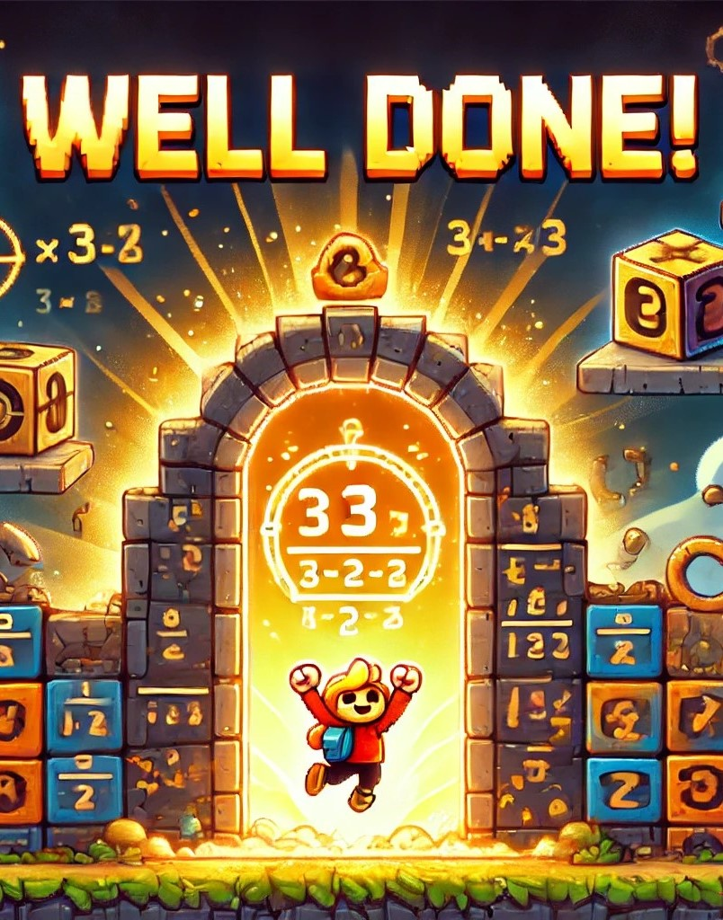
Hints: Get a Helping Hand
Need Help?
Learn as You Play
Notes:
Need Help?
If you need a hint, you can click on a highlighted box for some guidance.
Learn as You Play:
Hints can help you understand the concepts and practice your skills.

Slide 14



Detailed Explanations: Understand the Why
Learn from Mistakes
Improve Your Skills
Get detailed explanations after each level, showing how to solve the problem.
Understand the concepts better and improve your math skills by reviewing explanations.

Slide 15

Khan Academy Connection: Explore More!
1
2
Learn
Practice
Expand your knowledge with linked Khan Academy lessons for deeper learning.
Practice your math skills with additional interactive exercises and quizzes.

Slide 16
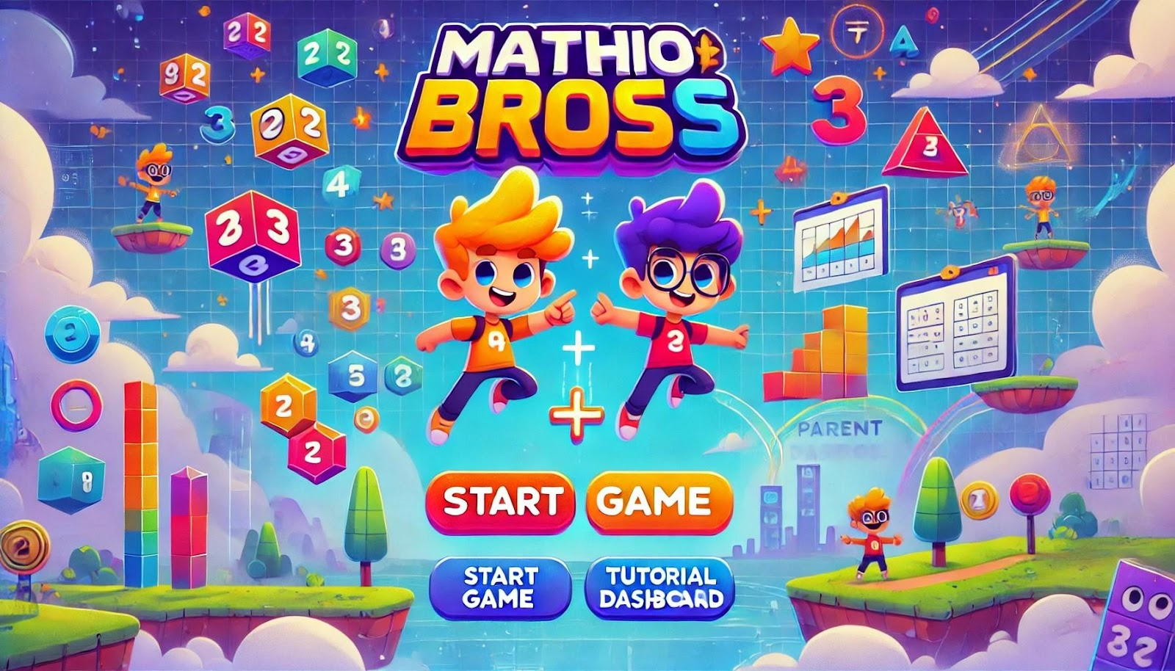
Landing Page :

Slide 17

Sign/Log-in page:

Slide 18
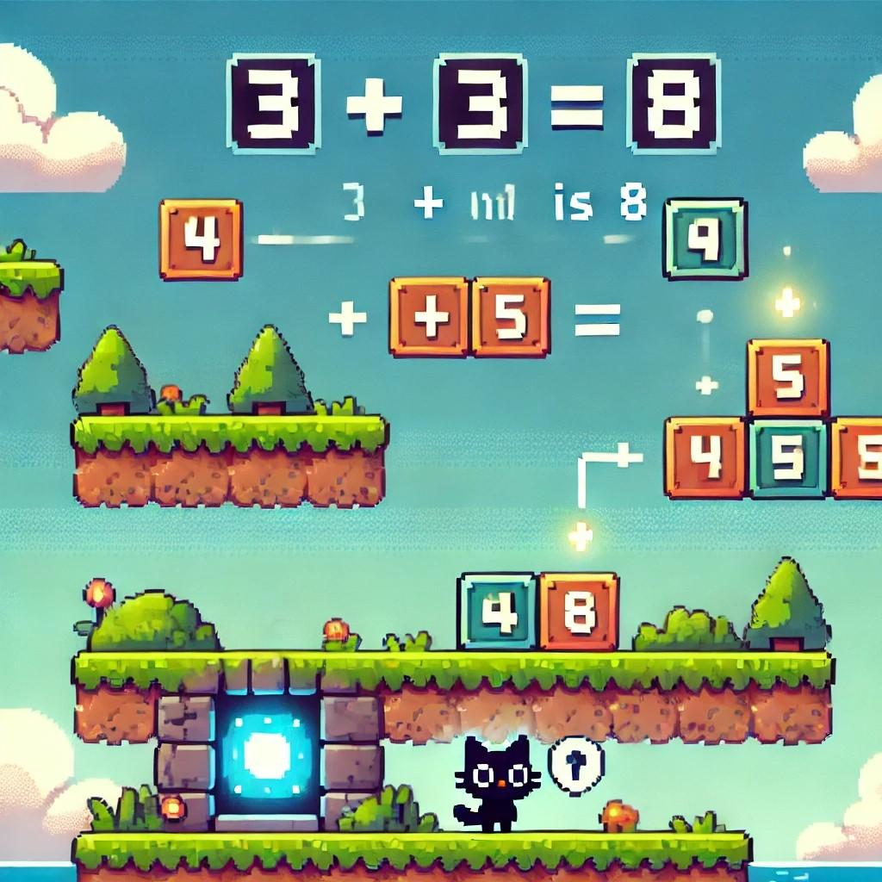
Basic level:

Slide 19
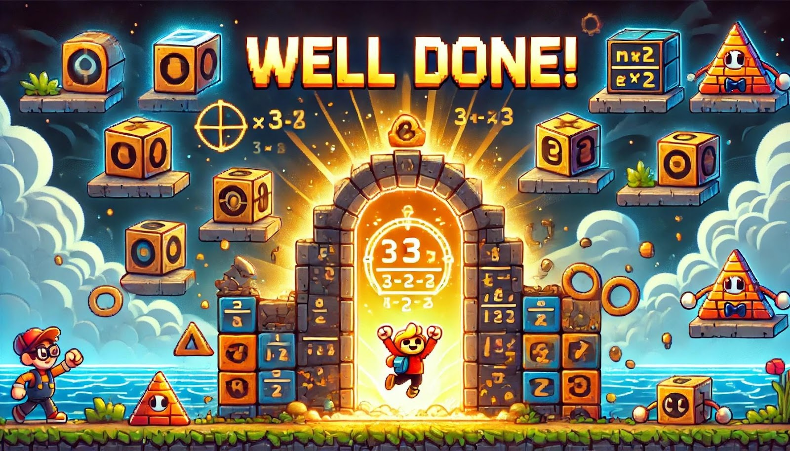
End level screen:

Slide 20
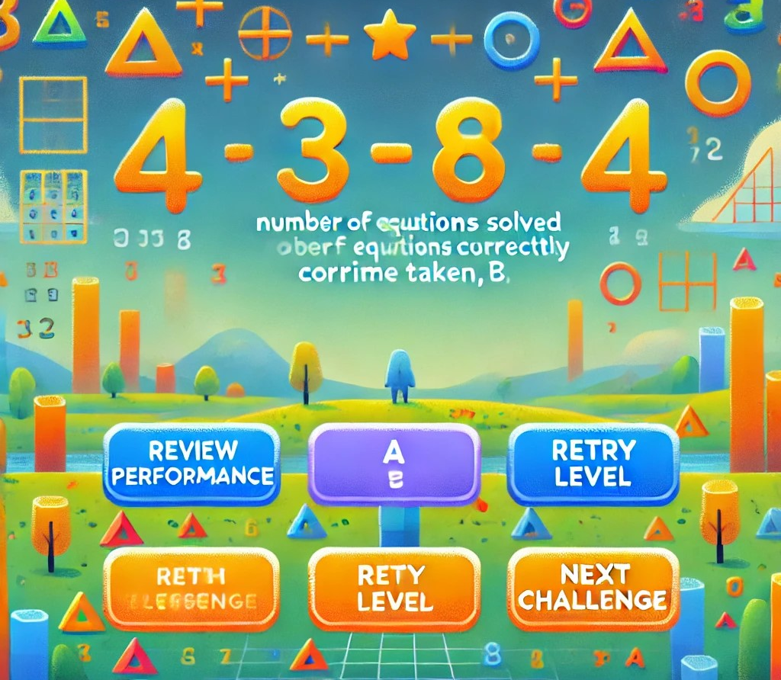
End Screen after end level:

Slide 21
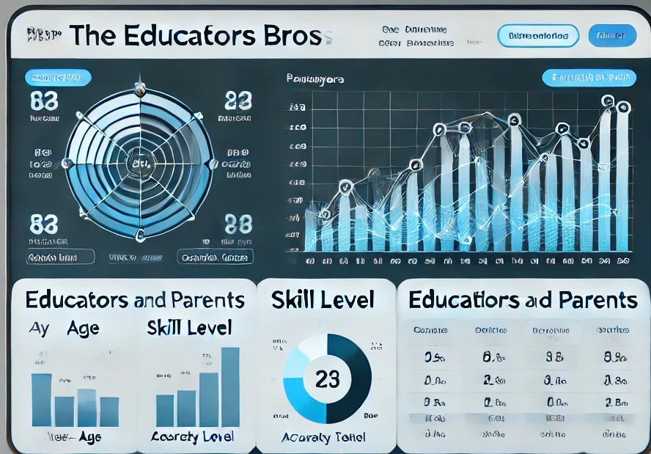
Dashboard for supervisors:

Slide 22
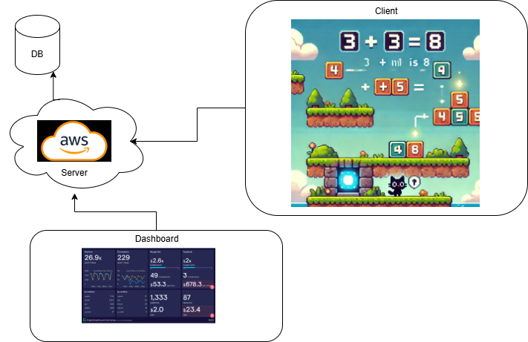
Architecture diagram:

Slide 23

Expected Outcomes and Unique Features
20%
80%
Accuracy Improvement
Engagement Rate
Increase in correctly solved math problems after 4 weeks of gameplay.
Percentage of assigned levels completed, with high retention after 2 weeks.
30%
75%
Efficiency Gain
Performance Improvement
Reduction in problem-solving time after 6 weeks of play.
Percentage of players showing noticeable progress in monitored metrics.

Slide 24
Verification and Evaluation Process
Game Application Testing
1
Verify core mechanics and performance.
Data Tracking Verification
2
Ensure accurate progress and performance tracking.
User Interface Testing
3
Assess usability and responsiveness of the game interface.
User Satisfaction Surveys
4
Collect feedback on gameplay experience and learning outcomes.

